Slide 1



Indian Premier League Analysis 2008-2022
View in Power BI
Last data refresh:
11-08-2023 12:32:45 UTC
Downloaded at:
11-10-2023 02:49:47 UTC

Slide 2
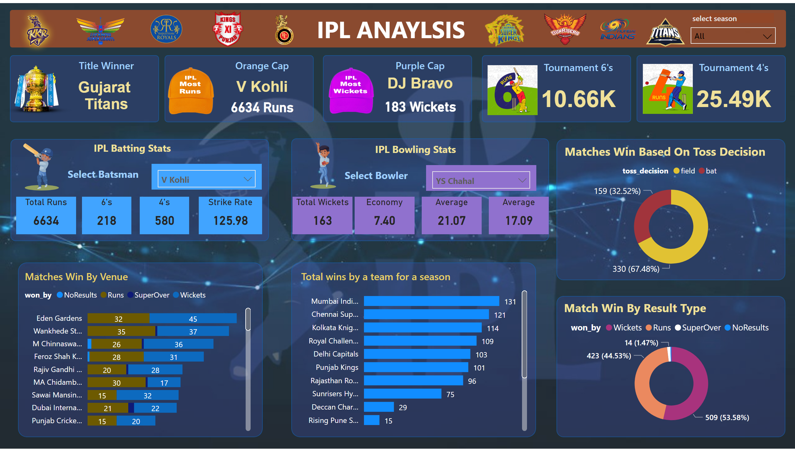
Page 1
Notes:
shape
No alt text provided
textbox
No alt text provided
Title Winner
No alt text provided
slicer
No alt text provided
shape
No alt text provided
shape
No alt text provided
shape
No alt text provided
shape
No alt text provided
shape
No alt text provided
Orange Cap
No alt text provided
Orange Cap
No alt text provided
Purple Cap
No alt text provided
Purple Cap
No alt text provided
Tournament 6's
No alt text provided
Tournament 4's
No alt text provided
shape
No alt text provided
shape
No alt text provided
slicer
No alt text provided
Total Runs
No alt text provided
6's
No alt text provided
4's
No alt text provided
Strike Rate
No alt text provided
textbox
No alt text provided
textbox
No alt text provided
slicer
No alt text provided
textbox
No alt text provided
Total Wickets
No alt text provided
Economy
No alt text provided
Average
No alt text provided
Average
No alt text provided
textbox
No alt text provided
shape
No alt text provided
Matches Win Based On Toss Decision
No alt text provided
shape
No alt text provided
Match Win By Result Type
No alt text provided
shape
No alt text provided
Matches Win By Venue
No alt text provided
shape
No alt text provided
Total wins by a team for a season
No alt text provided
image
No alt text provided
image
No alt text provided
image
No alt text provided
image
No alt text provided
image
No alt text provided
image
No alt text provided
image
No alt text provided
image
No alt text provided
image
No alt text provided
image
No alt text provided
image
No alt text provided
image
No alt text provided
image
No alt text provided
image
No alt text provided
image
No alt text provided
image
No alt text provided

